Slide 1

Solar Panel fault detection
Guided By:-
Ms. Deepika Gopal
Co-Founder, Renkube pvt. Ltd.
Presented By:-
Mohit Kumar Sharma (06111502819)

Slide 2
OUTLINES
Problem Statement
Objective
Type of faults
Methodology
Result
Conclusion

Slide 3
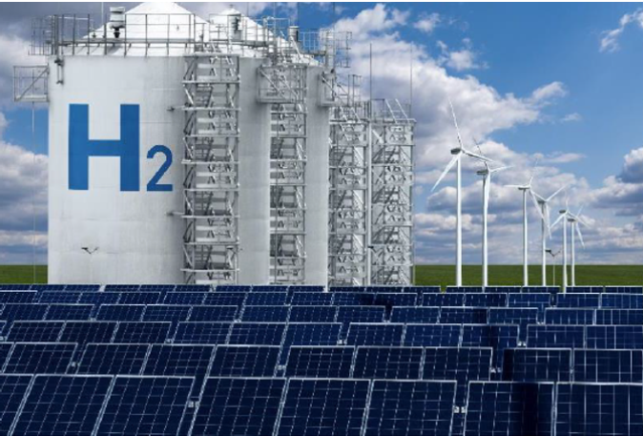
Problem Statement
Faults on individual modules within a photovoltaic (PV) array can have a significant detrimental effect on the power efficiency and reliability of the entire PV system.

Slide 4
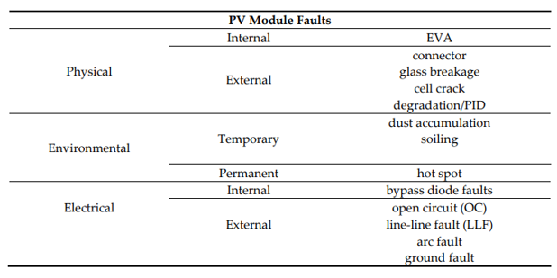
Types of faults

Slide 5
Objective
Aim of this project is to build model using unsupervised machine learning algorithm to detect the fault in a solar panel by comparing the powers by different loggers.

Slide 6
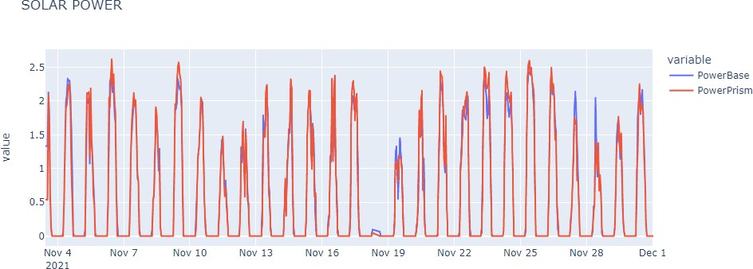
Methodology
DATASET
Dataset consist of powers from two loggers, Baseline and Prism per hour from August 2021 to January 2022.
Figure : Comparison between powers

Slide 7
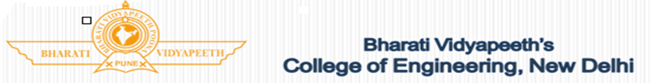
Methodology
Model
Isolation Forest, unsupervised machine learning algorithm is used for anomaly detection or fault detection.
Difference between both the powers is fit into the Isolation forest.
Time where the variation between powers of both loggers is much higher than that is the anomalous point.

Slide 8
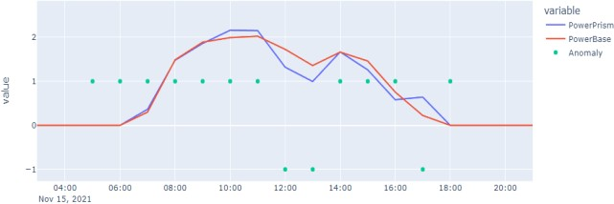
RESULT
Figure: Faults on 15th November

Slide 9
REFERENCES
[1] SUPSI. SMARTHELIO Innosuisse Check Project; Final Report; Innosuisse: Bern, Switzerland, 2020.
[2] Aghaei, M.; Fairbrother, A.; Gok,A.; Ahmad,S.; Kazim,S.; Lobato,K.; Oreski,G.; Reinders, A.; Schmitz,J.; Theelen, M.;Yilmaz, P.; Kettel,J. Review of degradation and failure phenomena in photovoltaic modules. Renew. Sustain. Energy Rev. 2022, 159, 112160. https://doi.org/10.1016/j.rser.2022.112160.
[3] Dhimish, M.; Holmes, V.; Mehrdad, B.; Dales, M.; Mather, P. Photovoltaic fault detection algorithm based on theoretical curves modelling and fuzzy classification system. Energy 2017, 140, 276–290. https://doi.org/10.1016/j.energy.2017.08.102.
[4] Nieto, A.E.; Ruiz, F.; Patino, D.; Ramirez, O. Classification of electric faults in photovoltaic systems based on voltage-power curves. IEEE Lat. Am. Trans. 2021, 19, 2071–2078. https://doi.org/10.1109/TLA.2021.9480149.

Slide 10
Thank you!

